Slide 1


TROUBLESHOOTING PC & DRIVERS
CSP-155

Slide 2

OBJECTIVES
Basic Troubleshooting Tips
Knowledge of operating system and device drivers
Identify hardware peripherals
Basic knowledge of safeguarding hardware
Apply knowledge to repair/maintain the computer

Slide 3

WHAT IS COMPUTER?
An electronic device, operating under the control of instructions stored in its own memory, that can:
– Accept data (input)
– Process the data according to speciﬁed rules (process)
– Produce results (output)
– Store the results (storage) for future use.

Slide 4
HARDWARE & SOFTWARE PROBLEMS
Were there any loud noises or smoke when the problem ﬁrst appeared? Then it is probably a hardware problem, with the most likely culprit being the SMPS(Switched Mode Power Supply )unit.
Is the computer entirely dead? Or the screen blank? Or the screen showing a poor/incomplete picture? These faults are probably also due to hardware problems.
Does the computer produce a series of beeps? This is a code that can be used to distinguish some hardware problems.
Does the system give any error codes or descriptions while booting? These can be due to hardware or software problems. Take careful note of all information given in the error code.
Does the computer produce error information acer it has booted or only when you open speciﬁc programs? These error codes are probably due to software problems.
Have any recent changes been made to hardware or software (including BIOS settings)? If so, these are likely culprits.

Slide 5
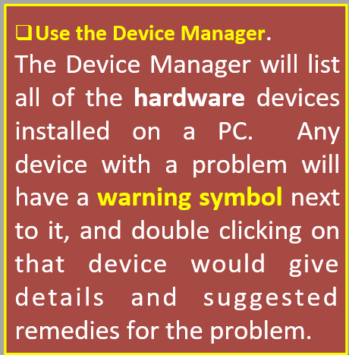
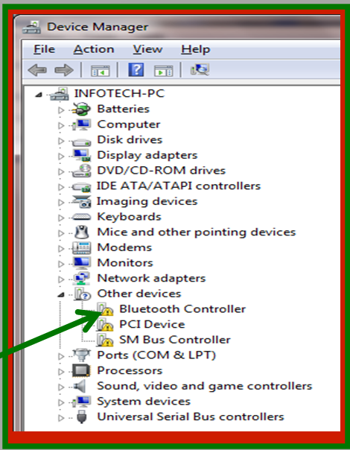
HARDWARE & SOFTWARE PROBLEMS
Has the computer been exposed to viruses or other malware? This could be a cause of software problems.
WARNING

Slide 6
Check harmful materials e.g. dust , virus, outdated software, faulty electrical Power/ gadget e.g. cables, sockets, extensions etc.
Check any malfunctions of peripherals.
Proper maintenance helps to keep the computer running smoothly for years.
Improving slow performance
Dust Control
Dust is very harmful for computer parts.
Excess dust can cause mechanical failures, particularly on computer components with moving parts.
Computers should be dusted regularly by using compressed air machines .
COMPUTER MAINTENANCE

Slide 7
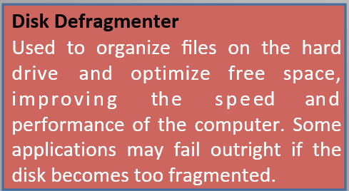
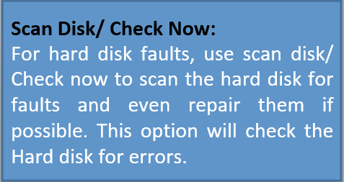
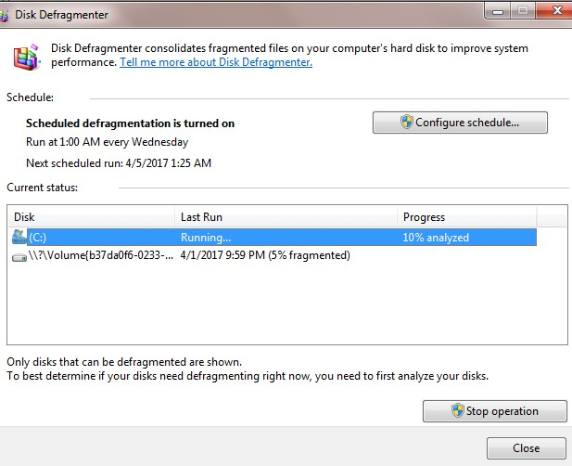
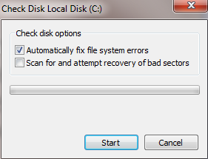
COMPUTER MAINTENANCE

Slide 8
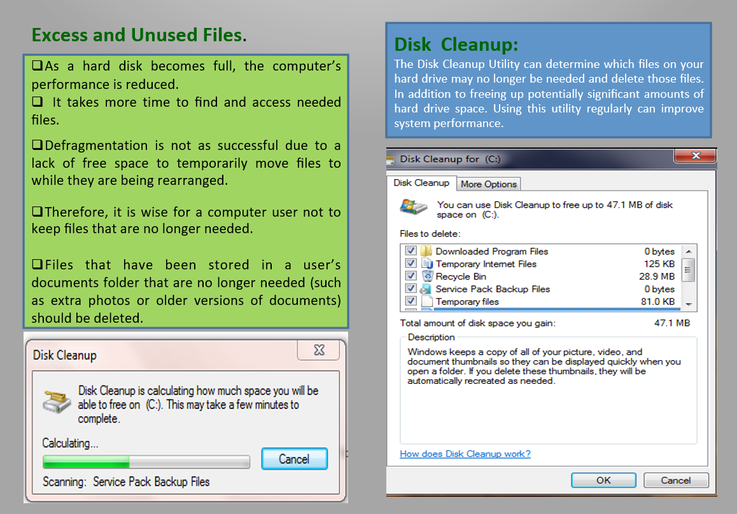
COMPUTER MAINTENANCE

Slide 9
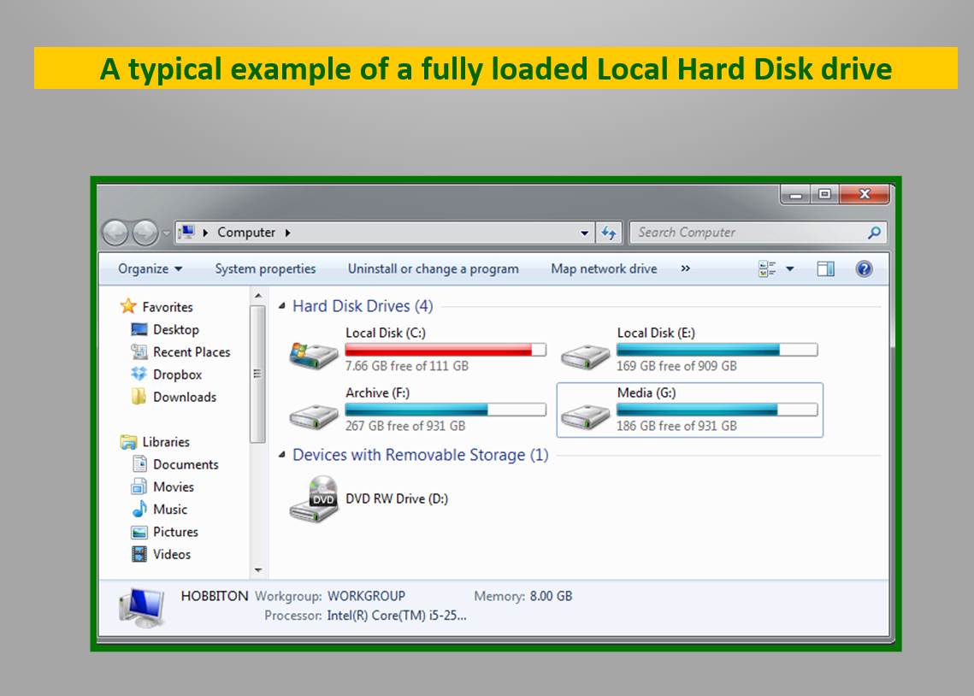
COMPUTER
MAINTENANCE

Slide 10
Deleting Browsing History
The browser stores the recent history of the web pages that the user has viewed,
This make it easier to ﬁnd and load these web pages again.
The browser also stores other small bits of information such as data entered into forms and usernames or passwords if a user has asked a web page to “remember me” (although this is not a good idea for shared computers).
This stored information can be easily deleted.
COMPUTER
MAINTENANCE
Protect your PC from cyber-threats or Malware The cyber-world is full of threats such as viruses, spyware, Trojans, Worms and etc. These cyber-threats can cause huge dilemmas to your computer. These undesirable programs, which are usually added without a user’s knowledge, can signiﬁcantly slow down the performance of a computer.
The best ways to prevent virus infections are:
Keeping antivirus software up to date and running scans on a regular basis
Strict policies should be put in place to prevent virus infection e.g. prohibiting the use of ﬂash drives, or require Flash disk to be scanned before use.
Other policy to consider is the prohibition of downloading, since unsuspecting users can accidentally download malware.
A ﬁrewall may also be used to blocks dangerous downloads.

Slide 11
UPDATING SOFTWARE
It is important for a computer user to ﬁnd and install software updates in order to have well performing computers.
Updating software can be done in a variety of ways, Automatic Updates, Automatic Alerts for Updates, Manual Updating, Oﬄine Updating.
COMPUTER
MAINTENANCE
Overheating
Excessive heat can cause a signiﬁcant decrease in computer performance.
1. In order to cool down an overheated computer processor, avoid operating the computer if the case is in an enclosed space. (such as a drawer or cupboard).
2. Also cool the room with fans or air-conditioning.
3. Also verify that all of the fans in the computer case are functioning properly.
Insuﬃcient RAM
Computer need suﬃcient RAM to perform the desired functions once the memory is not suﬃcient. The performance will be slow.

Slide 12
Repair means to rectify, to ﬁx the problem either in the hardware or software. it may also include replacement of a component that is faulty.
It is an essential part of troubleshooting.
In ﬁnding or analyzing the faults, it can be decided which hardware or software can be repaired.
For repairing or trouble-shooting a computer use the following guidelines:
Gather together your toolkit: e.g. air blowing machine, screw drivers, software, back up disk etc.
2. Check for power FIRST, before doing anything else, 10 - 15 percent of all computer Issues/Problems emanate from power surge.
3. Check your external connections to the computer.
4. Perform the Power On Self Test (POST)
POST is a set of procedures that a computer runs through each time it is turned on. It ensures that all of the system's hardware is working properly before trying to load the operating system.
HARDWARE REPAIRS

Slide 13
If the computer is still malfunctioning, go ahead then and open the case.
Check to see that all of the cards are fully pressed down into the bus connections, that any socketed chips are fully pressed into their sockets, and that all cable connections are fully attached. Make sure that the drive cables are attached correctly.
Clean any dust or foreign material out of the case while it is open.
Dust can cause overheating problems and electrical shorts. Sometimes, insects will nest inside the case as well. All of this needs to be cleaned out before you close up the case. Take precautions to avoid inhaling excess dust, and consider using protective eye ware if necessary
Check the CMOS setup program, and correct any conﬁguration problems.
If the information in CMOS RAM about your PC's conﬁguration has been changed, or if the battery has died, your computer will not boot correctly, or it will not recognize certain components.
Look for unwanted changes.
Someone may have turned the brightness down on a monitor, or the LAN staﬀ may have changed your PC's conﬁguration without your knowledge (or approval)
HARDWARE REPAIRS

Slide 14
The computer is unable to start up
If the computer does not turn on when you press the power button, the following suggestions may help you to determine why the computer will not start up.
First of all, check if the computer is plugged in to an AC outlet properly.
Plug another electrical device into the outlet to be sure that the outlet is providing adequate power. A surge protector can be used in this case, because voltage surges can be very damaging to computers and other electrical components. Then put on the system to perform a POST .
Acer the POST and it is conﬁrms that, the computer is producing all of the usual startup sounds and lights, but the monitor is not displaying any information, perhaps there is a problem with the monitor. Make sure that it is connected to a power source, and also that the VGA cable is connected to the computer.
The computer screen is blank
If the screen is blank, the computer may not be set to display the image on the computer screen.
First, check if the monitor is plugged in to a power outlet and is connected to the computer securely and make sure the monitor power button is on.
If the power light is not on, it means that the outlet is not delivering power to the monitor. Fixing the power outlet in such cases should help solve the issue.

Slide 15
The Blue screen
These errors are often caused by
Poorly functioning device drivers,
Hardware problems (such as memory, power supplies or system overheating),
Problems with the system software.
Trouble with video card
If the power light of the computer and monitor is on and nothing comes up on the screen when you start your computer then there must be something wrong with video card. Change its video or the graphics card with a new one.
Windows do not boot properly – If windows do not boot properly then you should reinstall windows with the windows recovery disk. Most of the times, this should help you get rid of the problem.
The computer is on but not responding – the computer is on but not responding to software or keyboard commands, then it must be frozen or halted.
Immediate solution:
Press and hold the power button for at least 5 seconds,
it will be turn oﬀ.
Now restart your computer

Slide 16
Malicious software, is any software used to disrupt computer or mobile operations, gather sensitive information, gain access to private computer systems, or display unwanted advertising.
These malicious software ﬁnd its way into:
Boot sector
File Allocation Table
Partition table
.Com and .Exe Files
VIRUS

Slide 17
Delete ﬁles
Change ﬁles,
Steal important information,
Load unwanted applications
Send documents via electronic mail (e-mail),
Cripple a machine’s Operating system (OS), the basic software that runs the computer.
EFFECT OF VIRUS

Slide 18
The computer’s performance slows down considerably.
Programs don’t function as thy should. They either don’t start, or if they start, they stop or do not give the desired output.
Computer fails to boot.
Files and folders keep disappearing without anybody deleting them.
The computer crashes or freezes indiscriminately such as program not responding errors.
The computer keeps showing out –of -memory space messages or strange dialog boxes.
Programs and windows popping up randomly.
Disk can not be accessed
New icons and programs get installed automatically.
Printing doesn't work correctly
Windows shuts down or restarts unexpectedly.
A partition in the system disappears automatically.
File size changes for no apparent reason
An increase in the number of files on the system when nothing has been added.
WARNING SIGNS OF
VIRUS

Slide 19
Scan for viruses Should be able to check your drives for viruses, as well as the RAM of your computer, and detect the presence of a virus.
Clean up the virus must be able to get rid of the virus it ﬁnds on your computer; otherwise, it is useless.
Protect your System from viruses Must have the ability to load a piece of the program into memory at boot-up time, to protect you from getting a virus in the ﬁrst place.
Provide Automatic updates Must regularly and automatically check back with the manufacturer for information on new viruses,
A GOOD VIRUS PROGRAM SHOULD

Slide 20
Always ensure that the power has been turned oﬀ before installing or troubleshooting any hardware part of the computer.
Before opening a computer case, always unplug the power cord from your computer.
Acer unplugging the power cord from your case, Hold the power button in for at least 5 seconds. This will drain any residual electricity from the power supply
Always ground yourself to the case frame while touching any inside components. This can be done by touching the case frame with your bare hand, or using a
clamp-on grounding device made speciﬁcally for this purpose
Keep all liquids away.
Avoid installing components when the computer is in operation.
When installing any, peripheral or device, always read the installation instructions that come with the device. Never apply force to try and connect any plug/device.
BEST PRACTICES/DOS
AND DON’T’S

Slide 21
When ﬁtting/handling processor on motherboard always wear gloves
Always choose to shut down you computer by clicking shutdown. Avoid switching of the power directly from the main switch.
If electrical power is lost, switch oﬀ all computer devices from the mains to avoid any problems due to power surge.
Always “eject “USB devices from the operating system before disconnecting them.
Upgrade the anti-virus regularly.
Always use UPS(uninterruptible Power supply)-This will keep your computer from crashing during power outages, and will protect your computer from low and high voltage occurrences.
Uninstall software by
“Add / Remove Program” function in Control Panel
uninstall function of applications
BEST PRACTICES/DOS
AND DON’T’S

Slide 22


BOOKS YOU CAN REFER
Build Your Own PC Do-It-Yourself For Dummies - Mark L. Chambers
Windows 10 Made Easy: Take Control of Your PC
Book by - James Bernstein
Laptops For Dummies
Book by - Dan Gookin
Troubleshooting And Maintaining Your PC All-in-One Desk Reference for Dummies
Book by - Dan Gookin

Slide 23
THANKS !
Prepared By : Samiksha Sharma Assistant Professor(CSE)

